Slide 1
What is a Math Lab?
(Part 1)

Slide 2
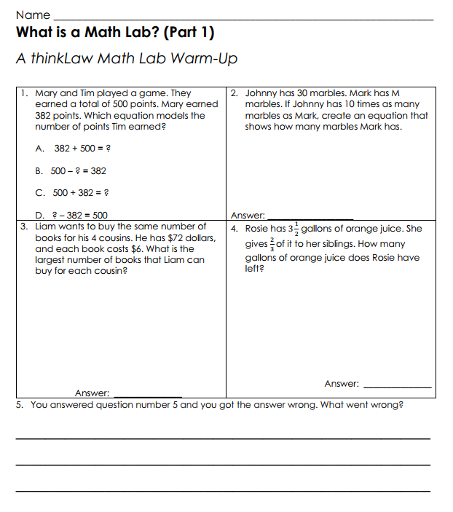
thinkWarm-Up
Before we begin…
Notes:
Probing Questions:
Have you ever been unsure when solving a math problem? How did that make you feel? Is it normal to feel unsure in math?
Did you know that there are some math problems that have never been solved? Why would someone keep working for years on a problem that has never been solved?
What strategies can we use when feeling unsure in math makes us feel anxious? What can we do to cope?
Why is feeling unsure an important part of learning math?

Slide 3
A critical thinker doesn’t just know things, they are also able to have the right dispositions or attitude.
This assessment is designed to help you gauge your critical thinking skills. By honestly answering these questions, you can track the changes in your critical thinking mindset over the course of the year.
Notes:
Probing Questions:
Have you ever been unsure when solving a math problem? How did that make you feel? Is it normal to feel unsure in math?
Did you know that there are some math problems that have never been solved? Why would someone keep working for years on a problem that has never been solved?
What strategies can we use when feeling unsure in math makes us feel anxious? What can we do to cope?
Why is feeling unsure an important part of learning math?

Slide 4
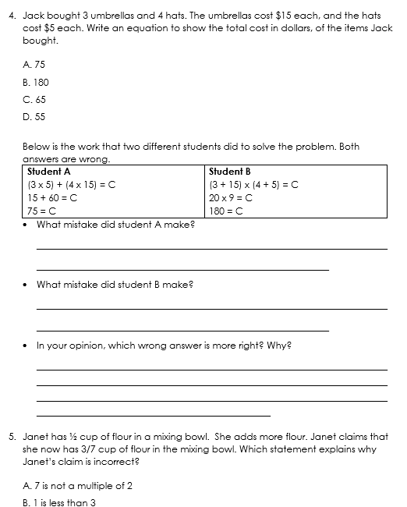
You will begin by solving 5 math problems. Try your best.
Notes:
Probing Questions:
Have you ever been unsure when solving a math problem? How did that make you feel? Is it normal to feel unsure in math?
Did you know that there are some math problems that have never been solved? Why would someone keep working for years on a problem that has never been solved?
What strategies can we use when feeling unsure in math makes us feel anxious? What can we do to cope?
Why is feeling unsure an important part of learning math?

Slide 5
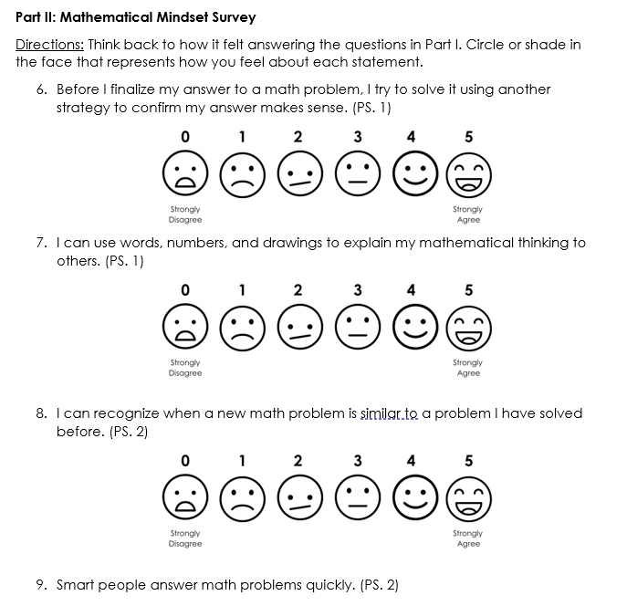
Next, you will complete the mindset section. There are 15 questions where you will reflect on their feelings immediately after solving the first 5 math questions.
Please follow these 4 instructions carefully.
Notes:
Probing Questions:
Have you ever been unsure when solving a math problem? How did that make you feel? Is it normal to feel unsure in math?
Did you know that there are some math problems that have never been solved? Why would someone keep working for years on a problem that has never been solved?
What strategies can we use when feeling unsure in math makes us feel anxious? What can we do to cope?
Why is feeling unsure an important part of learning math?

Slide 6
Honesty is Key
Be honest with yourself when answering these questions. There are no right or wrong answers. Your responses will help you measure your growth.
Notes:
Probing Questions:
Have you ever been unsure when solving a math problem? How did that make you feel? Is it normal to feel unsure in math?
Did you know that there are some math problems that have never been solved? Why would someone keep working for years on a problem that has never been solved?
What strategies can we use when feeling unsure in math makes us feel anxious? What can we do to cope?
Why is feeling unsure an important part of learning math?

Slide 7
Self-Reflection
Take a moment to reflect on each question before answering. Think about your thoughts, actions, and experiences at this moment in
time.
Notes:
Probing Questions:
Have you ever been unsure when solving a math problem? How did that make you feel? Is it normal to feel unsure in math?
Did you know that there are some math problems that have never been solved? Why would someone keep working for years on a problem that has never been solved?
What strategies can we use when feeling unsure in math makes us feel anxious? What can we do to cope?
Why is feeling unsure an important part of learning math?

Slide 8
Selecting the Best-Fit Response
For each question, select the response that best represents your current thoughts or behaviors.
0-Strongly Disagree
1-Disagree
2-Somewhat Disagree
3-Somewhat Agree
4-Agree
5-Strongly Agree
Notes:
Probing Questions:
Have you ever been unsure when solving a math problem? How did that make you feel? Is it normal to feel unsure in math?
Did you know that there are some math problems that have never been solved? Why would someone keep working for years on a problem that has never been solved?
What strategies can we use when feeling unsure in math makes us feel anxious? What can we do to cope?
Why is feeling unsure an important part of learning math?

Slide 9
Take Your Time
There's no need to rush! Take your time to think about each question
and provide thoughtful answers.
Notes:
Probing Questions:
Have you ever been unsure when solving a math problem? How did that make you feel? Is it normal to feel unsure in math?
Did you know that there are some math problems that have never been solved? Why would someone keep working for years on a problem that has never been solved?
What strategies can we use when feeling unsure in math makes us feel anxious? What can we do to cope?
Why is feeling unsure an important part of learning math?

Slide 10
Now, let’s get started!
Please proceed to answer each of the questions honestly and remember that this assessment is a valuable tool for
your personal growth in critical thinking.
Notes:
Probing Questions:
Have you ever been unsure when solving a math problem? How did that make you feel? Is it normal to feel unsure in math?
Did you know that there are some math problems that have never been solved? Why would someone keep working for years on a problem that has never been solved?
What strategies can we use when feeling unsure in math makes us feel anxious? What can we do to cope?
Why is feeling unsure an important part of learning math?

Slide 11
6. Before I finalize my answer to a math problem, I try to solve it using another strategy to confirm my answer makes sense. (PS. 1)
Notes:
Probing Questions:
Have you ever been unsure when solving a math problem? How did that make you feel? Is it normal to feel unsure in math?
Did you know that there are some math problems that have never been solved? Why would someone keep working for years on a problem that has never been solved?
What strategies can we use when feeling unsure in math makes us feel anxious? What can we do to cope?
Why is feeling unsure an important part of learning math?

Slide 12
7. I can use words, numbers, and drawings to explain my mathematical thinking to others. (PS. 1)
Notes:
Probing Questions:
Have you ever been unsure when solving a math problem? How did that make you feel? Is it normal to feel unsure in math?
Did you know that there are some math problems that have never been solved? Why would someone keep working for years on a problem that has never been solved?
What strategies can we use when feeling unsure in math makes us feel anxious? What can we do to cope?
Why is feeling unsure an important part of learning math?

Slide 13
I can recognize when a new math problem is similar to a problem I have solved before.
(PS. 2)
Notes:
Probing Questions:
Have you ever been unsure when solving a math problem? How did that make you feel? Is it normal to feel unsure in math?
Did you know that there are some math problems that have never been solved? Why would someone keep working for years on a problem that has never been solved?
What strategies can we use when feeling unsure in math makes us feel anxious? What can we do to cope?
Why is feeling unsure an important part of learning math?

Slide 14
9. Smart people answer math problems quickly. (PS. 2)
Notes:
Probing Questions:
Have you ever been unsure when solving a math problem? How did that make you feel? Is it normal to feel unsure in math?
Did you know that there are some math problems that have never been solved? Why would someone keep working for years on a problem that has never been solved?
What strategies can we use when feeling unsure in math makes us feel anxious? What can we do to cope?
Why is feeling unsure an important part of learning math?

Slide 15
10. When someone gets a different math answer than me, I am comfortable talking about our differences. (PS. 3)
Notes:
Probing Questions:
Have you ever been unsure when solving a math problem? How did that make you feel? Is it normal to feel unsure in math?
Did you know that there are some math problems that have never been solved? Why would someone keep working for years on a problem that has never been solved?
What strategies can we use when feeling unsure in math makes us feel anxious? What can we do to cope?
Why is feeling unsure an important part of learning math?

Slide 16
It’s important to solve math questions that use real-life problems with real-life numbers.
(PS. 4)
Notes:
Probing Questions:
Have you ever been unsure when solving a math problem? How did that make you feel? Is it normal to feel unsure in math?
Did you know that there are some math problems that have never been solved? Why would someone keep working for years on a problem that has never been solved?
What strategies can we use when feeling unsure in math makes us feel anxious? What can we do to cope?
Why is feeling unsure an important part of learning math?

Slide 17
I use math in my life outside of school.
(PS. 4)
Notes:
Probing Questions:
Have you ever been unsure when solving a math problem? How did that make you feel? Is it normal to feel unsure in math?
Did you know that there are some math problems that have never been solved? Why would someone keep working for years on a problem that has never been solved?
What strategies can we use when feeling unsure in math makes us feel anxious? What can we do to cope?
Why is feeling unsure an important part of learning math?

Slide 18
13. My interests and experiences help me learn math. (PS. 4)
Notes:
Probing Questions:
Have you ever been unsure when solving a math problem? How did that make you feel? Is it normal to feel unsure in math?
Did you know that there are some math problems that have never been solved? Why would someone keep working for years on a problem that has never been solved?
What strategies can we use when feeling unsure in math makes us feel anxious? What can we do to cope?
Why is feeling unsure an important part of learning math?

Slide 19
14. If someone doesn't understand how I got an answer, I can use tools to show them how to solve the problem in a way that makes sense to them. (PS. 5)
Notes:
Probing Questions:
Have you ever been unsure when solving a math problem? How did that make you feel? Is it normal to feel unsure in math?
Did you know that there are some math problems that have never been solved? Why would someone keep working for years on a problem that has never been solved?
What strategies can we use when feeling unsure in math makes us feel anxious? What can we do to cope?
Why is feeling unsure an important part of learning math?

Slide 20
15. There is usually only one right way to solve math problems. (PS. 5)
Notes:
Probing Questions:
Have you ever been unsure when solving a math problem? How did that make you feel? Is it normal to feel unsure in math?
Did you know that there are some math problems that have never been solved? Why would someone keep working for years on a problem that has never been solved?
What strategies can we use when feeling unsure in math makes us feel anxious? What can we do to cope?
Why is feeling unsure an important part of learning math?

Slide 21
16. Listening to other’s ideas about a math problem can help improve my understanding of math. (PS. 6)
Notes:
Probing Questions:
Have you ever been unsure when solving a math problem? How did that make you feel? Is it normal to feel unsure in math?
Did you know that there are some math problems that have never been solved? Why would someone keep working for years on a problem that has never been solved?
What strategies can we use when feeling unsure in math makes us feel anxious? What can we do to cope?
Why is feeling unsure an important part of learning math?

Slide 22
17. When I don't know how to solve a math problem, I am comfortable asking questions. (PS. 6)
Notes:
Probing Questions:
Have you ever been unsure when solving a math problem? How did that make you feel? Is it normal to feel unsure in math?
Did you know that there are some math problems that have never been solved? Why would someone keep working for years on a problem that has never been solved?
What strategies can we use when feeling unsure in math makes us feel anxious? What can we do to cope?
Why is feeling unsure an important part of learning math?

Slide 23
18. Math vocabulary helps me explain my thinking to others and improves my understanding of math. (PS. 6)
Notes:
Probing Questions:
Have you ever been unsure when solving a math problem? How did that make you feel? Is it normal to feel unsure in math?
Did you know that there are some math problems that have never been solved? Why would someone keep working for years on a problem that has never been solved?
What strategies can we use when feeling unsure in math makes us feel anxious? What can we do to cope?
Why is feeling unsure an important part of learning math?

Slide 24
19. To understand big math problems, I can look for smaller ones inside the bigger ones that I already understand. (PS. 7)
Notes:
Probing Questions:
Have you ever been unsure when solving a math problem? How did that make you feel? Is it normal to feel unsure in math?
Did you know that there are some math problems that have never been solved? Why would someone keep working for years on a problem that has never been solved?
What strategies can we use when feeling unsure in math makes us feel anxious? What can we do to cope?
Why is feeling unsure an important part of learning math?

Slide 25
20. I can recognize patterns in math problems, and I use that knowledge to find quicker ways to solve them. (PS. 8)
Notes:
Probing Questions:
Have you ever been unsure when solving a math problem? How did that make you feel? Is it normal to feel unsure in math?
Did you know that there are some math problems that have never been solved? Why would someone keep working for years on a problem that has never been solved?
What strategies can we use when feeling unsure in math makes us feel anxious? What can we do to cope?
Why is feeling unsure an important part of learning math?

Slide 26
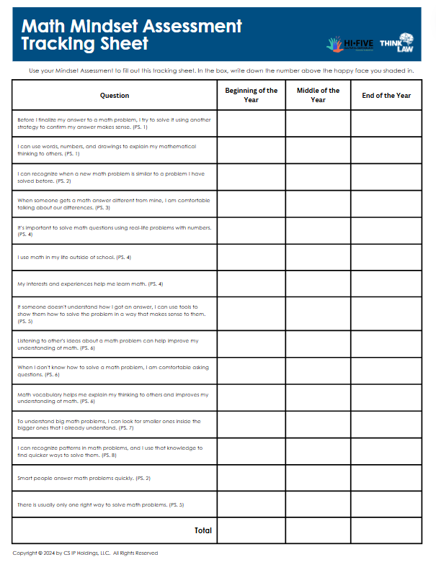
Use your assessment to fill in the end-of-year part of your tracking sheet.
To complete the tracking sheet, look at each question and write the number above the happy face you shaded in. Don’t forget to add up the total in the last
Notes:
Probing Questions:
Have you ever been unsure when solving a math problem? How did that make you feel? Is it normal to feel unsure in math?
Did you know that there are some math problems that have never been solved? Why would someone keep working for years on a problem that has never been solved?
What strategies can we use when feeling unsure in math makes us feel anxious? What can we do to cope?
Why is feeling unsure an important part of learning math?

Slide 27
Math Lab = Real Life
Why do we call them math labs? Just like a
science lab is an opportunity for you to try
what you’re learning in science, our math
labs let you use math with real-life legal
cases and issues!
Notes:
Probing Questions:
Have you ever been unsure when solving a math problem? How did that make you feel? Is it normal to feel unsure in math?
Did you know that there are some math problems that have never been solved? Why would someone keep working for years on a problem that has never been solved?
What strategies can we use when feeling unsure in math makes us feel anxious? What can we do to cope?
Why is feeling unsure an important part of learning math?

Slide 28
Five boys were walking home along a railroad track in New Jersey. The youngest boy found an old sock that was tied shut and contained something heavy.
He picked the sock up and swung it. The oldest boy took it from the youngest boys and started hitting the others with the sock. The sock then passed from boy to boy to boy, and every boy played with the sock for a short period of time.
As the boys were playing with the sock, the sock broke open and $775 in cash spilled out.
Who should own this money? Why?

Slide 29
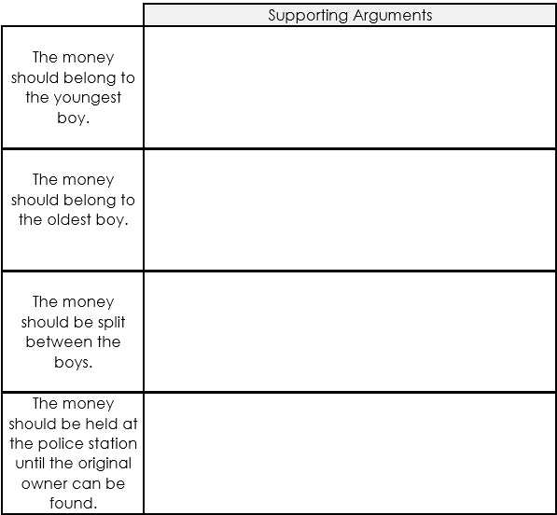
What’s the best argument for each of these to keep all of the money?

Slide 30
What did the court decide?
The Court ordered that the boys needed to split the money.
Notes:
Probing Questions:
Have you ever been unsure when solving a math problem? How did that make you feel? Is it normal to feel unsure in math?
Did you know that there are some math problems that have never been solved? Why would someone keep working for years on a problem that has never been solved?
What strategies can we use when feeling unsure in math makes us feel anxious? What can we do to cope?
Why is feeling unsure an important part of learning math?

Slide 31
The total was $775.
How much money will each of the 5 boys receive?
Use a visual representation to describe it.
Notes:
Probing Questions:
Have you ever been unsure when solving a math problem? How did that make you feel? Is it normal to feel unsure in math?
Did you know that there are some math problems that have never been solved? Why would someone keep working for years on a problem that has never been solved?
What strategies can we use when feeling unsure in math makes us feel anxious? What can we do to cope?
Why is feeling unsure an important part of learning math?

Slide 32
Many important United States and world leaders have been lawyers. Law is a universal language that controls almost everything around us.
Imagine how powerful your mind could be if you learned how to think like a lawyer!

Slide 33
thinkLaw will help you learn to think critically using real-life legal cases. You will learn how to argue both sides of a case, conduct investigations, settle disputes, make difficult decisions, and write persuasively.

Slide 34
How does that connect to math?
Notes:
Allow thinkers to share their ideas. Sample responses may include:
Lawyers use critical thinking to solve problems. We need to use critical thinking in math to solve problems.
When you approach a problem, you need to collect important information.

Slide 35
Why is it important to practice math with real life math examples?
Notes:
Allow thinkers to share their ideas. Sample responses may include:
Lawyers use critical thinking to solve problems. We need to use critical thinking in math to solve problems.
When you approach a problem, you need to collect important information.

Slide 36
In part 2 of this lesson, we will look at some tips to master math labs!
Notes:
Allow thinkers to share their ideas. Sample responses may include:
Lawyers use critical thinking to solve problems. We need to use critical thinking in math to solve problems.
When you approach a problem, you need to collect important information.

Slide 37
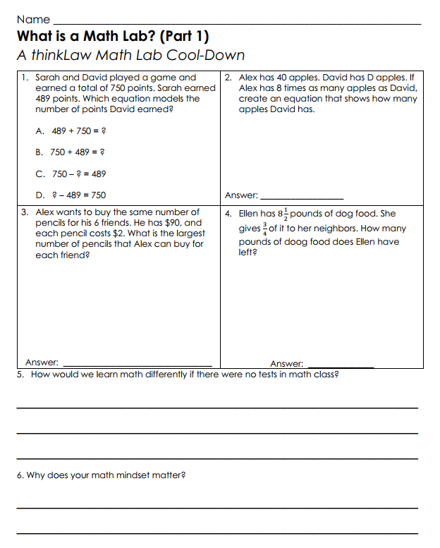
thinkCool-down
Before we finish…
Notes:
Probing Questions:
Have you ever been unsure when solving a math problem? How did that make you feel? Is it normal to feel unsure in math?
Did you know that there are some math problems that have never been solved? Why would someone keep working for years on a problem that has never been solved?
What strategies can we use when feeling unsure in math makes us feel anxious? What can we do to cope?
Why is feeling unsure an important part of learning math?

