Slide 1
Advocating in Action
A THINKLAW MATH LAB CULMINATING PROJECT (PART 3)

Slide 2
In 2022, 7th—and 8th-grade students at Cardinal Academy in Kentucky learned about the rise of teen vaping through a thinkLaw lesson. They wrote to their representatives and presented different ideas to address the problems of teen vaping and possible solutions to the issue.
Their representative, Michael Pollock, not only read those emails but also visited their school to let the students know in person that their voice matters!

Slide 3
Last time, you used the DRAAW+C chart to write your persuasive advocacy piece.
Today, you will finish and present your work.

Slide 4
A rubric is a tool for listing the requirements for a piece of work. It helps everyone evaluate their work clearly and consistently.
Use the rubric as a guide when preparing for your presentation.

Slide 5
When there is a conflict, it’s often helpful to investigate. As part of the investigation, you need to gather evidence. Physical evidence can be papers, photographs, videos, forms, or any other physical items that may be important to the case.
You will now have time to create at least 1 piece of physical evidence as part of your presentation. This should be something visual for the audience to see.
As you create your evidence, it’s helpful to consider how this evidence will help prove your case or convince your audience.

Slide 6
Sharing your work publicly can be intimidating. Despite that, why is advocating important?
How does having a growth mindset help you when presenting?

Slide 7
Presentation time!

Slide 8
Rubrics help us evaluate work. How would you score yourself? Do you think your teacher would score you differently? Why or why not?
What feedback would you give yourself?

Slide 9
You have completed several Math Labs, identified how your math mindset has shifted, and presented your idea to help math instruction be better for all students. How would you complete this sentence?
Math classes should include more ___________ to ensure our math identity and confidence continue to grow.

Slide 10
You did it!
Congratulations on all your hard work; we are proud of you!
Let’s take a minute to review. What steps did you take to complete this project?

Slide 11
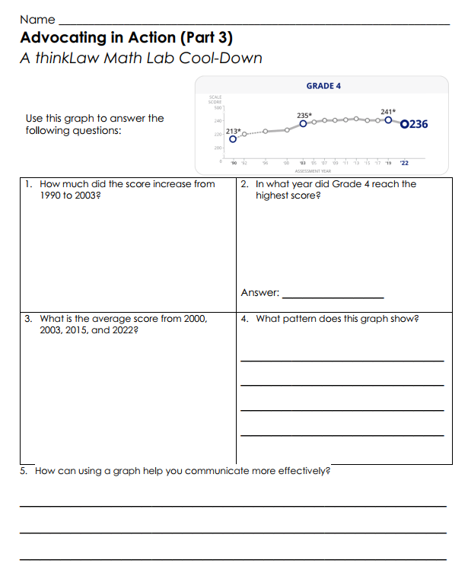
thinkCool-down
Before we finish…
Notes:
Probing Questions:
Have you ever been unsure when solving a math problem? How did that make you feel? Is it normal to feel unsure in math?
Did you know that there are some math problems that have never been solved? Why would someone keep working for years on a problem that has never been solved?
What strategies can we use when feeling unsure in math makes us feel anxious? What can we do to cope?
Why is feeling unsure an important part of learning math?

