Slide 1
Is it Fair to Trick Kids?
A thinkLaw Math Lab

Slide 2
thinkStarter
Family Feud is a game show. Two families compete. The host asks a survey question that was asked to a group of 100 people, such as, “Name the hour that you get up on Sunday mornings.”
Contestants must guess the most popular response. The game continues until one family has guessed all the answers on the board, or until time runs out.

Slide 3
If we surveyed 100 students in our school and asked them, “What is the most common mistakes that students make on math tests?” What would be the #1 response? | If we surveyed 100 students in our school and asked them, “What is the most common mistakes that students make on math tests?” What would be the #1 response?
1
2
3

Slide 4
If we surveyed 100 students in our school and asked them, “What are the ways test makers try to trick kids on standardized math tests?” What would be the #1 response? | If we surveyed 100 students in our school and asked them, “What are the ways test makers try to trick kids on standardized math tests?” What would be the #1 response?
1
2
3

Slide 5
thinkStarter Summary
There are common mistakes that students make on math tests. The people who make tests use mistake analysis to help them write questions that will trick kids.
Mistake analysis is when you spend time thinking critically about mistakes. Is this fair? In this thinkLaw math lab, we will think more about mistake analysis and thinking like a test maker.

Slide 6
What Would Joe Schmo Do?
Today we are going to think about Joe Schmo. Joe always falls for the trick answer. Joe does not read the directions carefully. Joes does not complete all the steps in a problem.
We are going to think about the mistakes Joe may make on a math test.

Slide 7
Question 1
For a concert, there are student tickets and adult tickets for sale. Of the total tickets 39/100 have been sold as student tickets and 5/10 as adult tickets. The rest of the tickets have not been sold. What fraction of the total number of tickets for the concert have not been sold?
If we surveyed 100 students in our school and asked them, “What mistake would Joe Schmo make on this question?” What would be the #1 response? | If we surveyed 100 students in our school and asked them, “What mistake would Joe Schmo make on this question?” What would be the #1 response?
1
2
3

Slide 8
Question 1
Use these top three mistakes to write a multiple-choice question. Be sure to also include the correct response.
For a concert, there are student tickets and adult tickets for sale. Of the total tickets 39/100 have been sold as student tickets and 5/10 as adult tickets. The rest of the tickets have not been sold. What fraction of the total number of tickets for the concert have not been sold? | For a concert, there are student tickets and adult tickets for sale. Of the total tickets 39/100 have been sold as student tickets and 5/10 as adult tickets. The rest of the tickets have not been sold. What fraction of the total number of tickets for the concert have not been sold?
A
B
C
D

Slide 9
Question 2
Rosa’s favorite sports team has won 0.62 of its games this season. How can Rosa express this decimal as a fraction? Write the fraction in simplest form.
If we surveyed 100 students in our school and asked them, “What mistake would Joe Schmo make on this question?” What would be the #1 response? | If we surveyed 100 students in our school and asked them, “What mistake would Joe Schmo make on this question?” What would be the #1 response?
1
2
3

Slide 10
Question 2
Use these top three mistakes to write a multiple-choice question. Be sure to also include the correct response.
Rosa’s favorite sports team has won 0.62 of its games this season. How can Rosa express this decimal as a fraction? Write the fraction in simplest form. | Rosa’s favorite sports team has won 0.62 of its games this season. How can Rosa express this decimal as a fraction? Write the fraction in simplest form.
A
B
C
D

Slide 11
Question 3
Jessica keeps track of the number of books each student checks out from the library. How many students check out more than three books? Use the line plot to answer the question.
If we surveyed 100 students in our school and asked them, “What mistake would Joe Schmo make on this question?” What would be the #1 response? | If we surveyed 100 students in our school and asked them, “What mistake would Joe Schmo make on this question?” What would be the #1 response?
1
2
3
Books Checked Out by Students
x
x
x
x
x
x
x
x
x
x
x
x
x
x
x
x
x
x
x
x
1
2
3
4
5
Number of Books

Slide 12
Question 3
Use these top three mistakes to write a multiple-choice question. Be sure to also include the correct response.
Jessica keeps track of the number of books each student checks out from the library. How many students check out more than three books? Use the line plot to answer the question. | Jessica keeps track of the number of books each student checks out from the library. How many students check out more than three books? Use the line plot to answer the question.
A
B
C
D
Books Checked Out by Students
x
x
x
x
x
x
x
x
x
x
x
x
x
x
x
x
x
x
x
x
1
2
3
4
5
Number of Books

Slide 13
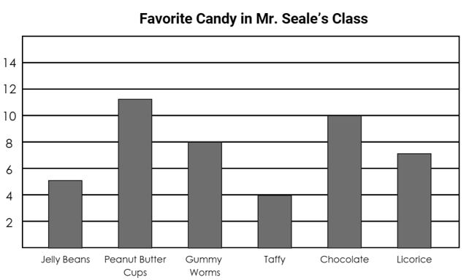
Question 4
Mr. Seale graphs his students’ favorite candy. The class has earned a candy party. All bowls of candy have the same amount to start with. Which two candies are likely to run out first? Use the graph to answer the question.
If we surveyed 100 students in our school and asked them, “What mistake would Joe Schmo make on this question?” What would be the #1 response? | If we surveyed 100 students in our school and asked them, “What mistake would Joe Schmo make on this question?” What would be the #1 response?
1
2
3

Slide 14
Question 4
Use these top three mistakes to write a multiple-choice question. Be sure to also include the correct response.
Mr. Seale graphs his students’ favorite candy. The class has earned a candy party. All bowls of candy have the same amount to start with. Which two candies are likely to run out first? Use the graph to answer the question. | Mr. Seale graphs his students’ favorite candy. The class has earned a candy party. All bowls of candy have the same amount to start with. Which two candies are likely to run out first? Use the graph to answer the question.
A
B
C
D

Slide 15
Question 5
The school building is 36 feet high. What is the height of the building in yards?
If we surveyed 100 students in our school and asked them, “What mistake would Joe Schmo make on this question?” What would be the #1 response? | If we surveyed 100 students in our school and asked them, “What mistake would Joe Schmo make on this question?” What would be the #1 response?
1
2
3

Slide 16
Question 5
Use these top three mistakes to write a multiple-choice question. Be sure to also include the correct response.
The school building is 36 feet high. What is the height of the building in yards? | The school building is 36 feet high. What is the height of the building in yards?
A
B
C
D

Slide 17
Question 6
Which number correctly completes the subtraction sentence 5.0 – 3.25 = _____?
If we surveyed 100 students in our school and asked them, “What mistake would Joe Schmo make on this question?” What would be the #1 response? | If we surveyed 100 students in our school and asked them, “What mistake would Joe Schmo make on this question?” What would be the #1 response?
1
2
3

Slide 18
Question 6
Use these top three mistakes to write a multiple-choice question. Be sure to also include the correct response.
Which number correctly completes the subtraction sentence 5.0 – 3.25 = _____? | Which number correctly completes the subtraction sentence 5.0 – 3.25 = _____?
A
B
C
D

Slide 19
What are the top 3 ways thinking like a test maker helps you take a standardized test | What are the top 3 ways thinking like a test maker helps you take a standardized test
1
2
3

Slide 20
thinkBigger
Do you think it is fair for test makers to use mistake analysis to trick kids?
What is the best argument for each side?
It is fair for test makers to use mistake analysis. | It is NOT fair for test makers to use mistake analysis.

