Slide 1
Who Should Get What?
Part 1
A thinkLaw Math Lab

Slide 2
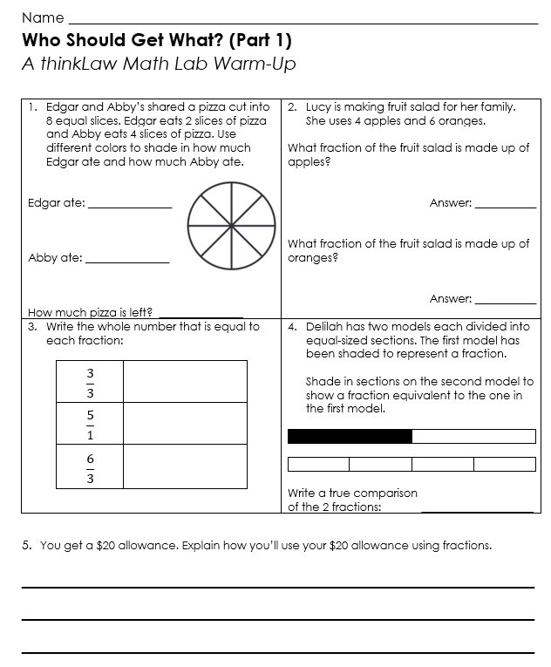
thinkWarm-Up
Before we begin
.

Slide 3
thinkStarter
Imagine that the school was on fire. The fire department can come and put out the fire, but the fire department would not be able to help you with anything else. For example, the fire department would not be able to help replace textbooks or school supplies.
.

Slide 4
What help would the school need to recover from the fire?
What does the school need? | Who could help?

Slide 5
thinkStarter Summary
Disasters can cause a lot of damage. Sometimes it requires extra help to rebuild.
Where are the Helpers?
FEMA stands for Federal Emergency Management Agency. FEMA is part of the U.S. government that helps people who have been impacted by natural disasters, such as hurricanes, floods, and earthquakes.

Slide 6
FEMA provides help. Here are a few examples of how FEMA helps. Rank the three examples from most important to least important.
Financial Assistance | Temporary Housing | Crisis Counseling
FEMA can help people pay for the cost of repairing their homes and businesses, as well as for other expenses such as food and clothing. | FEMA can provide temporary housing to people who have lost their homes in a disaster. | FEMA can provide crisis counseling to people who have been traumatized by a disaster.
Rank: | Rank: | Rank:
Why did you pick that order?

Slide 7
Who Gets What?
When FEMA arrives to help with a disaster, they have a set amount of money to use. FEMA must decide how to divide the money.
Splitting the money evenly between every need is not practical. Some needs are more expensive than others. In this thinkLaw math lab you will consider several real-life disasters and determine how FEMA should divide the money.

Slide 8
Disaster: Hawaii Wildfires (2023) | Disaster: Hawaii Wildfires (2023)
What happened? In the summer of 2023, Hawaii had a series of wildfires that burned thousands of acres of land. It took several weeks to put out the fires. Wildfires are a serious problem in Hawaii because the islands are dry and windy. This allows fires to spread quickly. | What happened? In the summer of 2023, Hawaii had a series of wildfires that burned thousands of acres of land. It took several weeks to put out the fires. Wildfires are a serious problem in Hawaii because the islands are dry and windy. This allows fires to spread quickly.
What was the impact? Thousands of people were displaced from their homes. At least 30 people suffered serious injuries or burns. Other people have gotten sick from breathing the smoke. Hundreds of businesses were destroyed. There was a lot of environmental damage. The fires burned native forest and grasslands. The fire released pollution into the air and water. | How much money did FEMA have to spend? $5.8 million

Slide 9
What resources will the people of Hawaii need? List your top 5 ideas and then rank them by importance. 1 is the most important.
Rank | Need | Fraction
$5.8 Million | $5.8 Million | $5.8 Million | $5.8 Million | $5.8 Million | $5.8 Million | $5.8 Million | $5.8 Million | $5.8 Million | $5.8 Million | $5.8 Million | $5.8 Million

Slide 10
Disaster: Cedar Rapids Flood (2008) | Disaster: Cedar Rapids Flood (2008)
What happened? In the summer of 2008, Cedar Rapids, Iowa, experienced heavy rains over several days. The heavy rain led to a flood. Flood waters were over 31.12 feet high. | What happened? In the summer of 2008, Cedar Rapids, Iowa, experienced heavy rains over several days. The heavy rain led to a flood. Flood waters were over 31.12 feet high.
What was the impact? Over 5,000 homes and businesses were destroyed. Many public buildings were damaged in the flood, including schools, libraries, and government offices. There was tremendous damage to infrastructure, such as roads, bridges, water, and sewer lines. When everything is covered in water, there becomes a problem with mold. When people are exposed to mold, they can become sick. | How much money did FEMA have to spend? $1 Billion

Slide 11
What resources will the people of Cedar Rapids need? List your top 4 ideas and then rank them by importance. 1 is the most important.
Rank | Need | Fraction
$1 Billion | $1 Billion | $1 Billion | $1 Billion | $1 Billion | $1 Billion | $1 Billion | $1 Billion | $1 Billion | $1 Billion | $1 Billion | $1 Billion

Slide 12
Disaster: Joplin Tornado (2011) | Disaster: Joplin Tornado (2011)
What happened? On May 22, 2011, a tornado struck the city of Joplin, Missouri. The tornado was rated EF5, which is the highest possible rating for a tornado. The tornado had winds of up to 200 miles per hour and was more than a mile wide. | What happened? On May 22, 2011, a tornado struck the city of Joplin, Missouri. The tornado was rated EF5, which is the highest possible rating for a tornado. The tornado had winds of up to 200 miles per hour and was more than a mile wide.
What was the impact? The tornado destroyed more than 8,000 homes and businesses and damaged even more. The tornado flattened entire neighborhoods. The storm destroyed the city’s powerlines. It damaged roads and bridges. Over 1,000 people were injured by the tornado. This tornado was one of the costliest tornadoes in U.S. history, it caused about $2.8 billion in damages. | How much money did FEMA have to spend? $1.5 Billion

Slide 13
What resources will the people of Joplin need? List your top 5 ideas and then rank them by importance. 1 is the most important.
Rank | Need | Fraction
$1.5 Billion | $1.5 Billion | $1.5 Billion | $1.5 Billion | $1.5 Billion | $1.5 Billion | $1.5 Billion | $1.5 Billion | $1.5 Billion | $1.5 Billion | $1.5 Billion | $1.5 Billion

Slide 14
thinkBigger
When the government gives money to FEMA, FEMA needs to be responsible with the money. FEMA employees need to explain to the public how they spent the money.
Pick 1 of the disasters. How would you explain how you spent the money? Be sure to use your fractions as part of your explanation.
How did you spend the money?

Slide 15
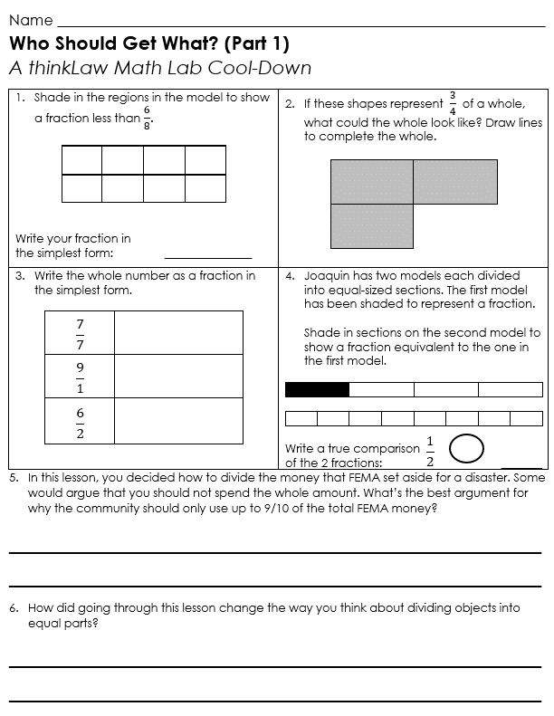
thinkCool-Down
Before we finish
.

