Slide 1
How Else Can I Explain?
A thinkLaw Math Lab

Slide 2
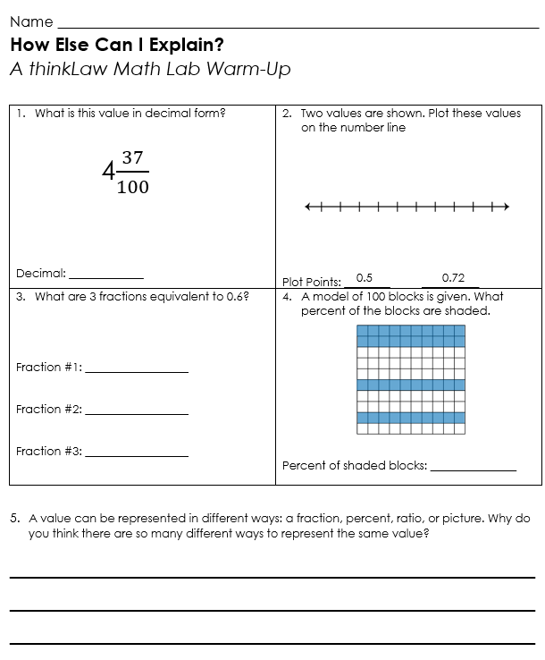
thinkWarm-Up
Before we begin.

Slide 3
thinkStarter
There are many ways to write numbers that are equal. Look at the examples below. All these values are equal. Which value do you think is the easiest for you to picture in your head?
Rank the values from 1-4. 1 is the easiest for you to picture in your head and 4 is the most difficult for you to picture in your head.
Explain your reasoning:

Slide 4
thinkStarter
Imagine you know Joe Schmo. Joe is very easily confused. Joe makes all the most common mistakes in math.
Rank the values from 1-4. 1 is the easiest for Joe to picture in his head and 4 is the most difficult for Joe to picture in his head.
Explain your reasoning:

Slide 5
thinkStarter Summary
When we share numbers with people there are many ways that we can show the same value. In today’s thinkLaw lesson, we will think about how the government should share important information with the public.

Slide 6
Take a Census (2021)
A census is when a government counts and records information about a
specific group of people.
In the United States, we have a census where the government counts everyone that lives in the country. The government also collects information such as:
• How many people live in each city?
• How much money do people make?
• How many people have college degrees?
The government uses that information to help them make important decisions. Why does the government need this information?

Slide 7
 | How will the government use this information?
How many people live in each city?
How much money do people make?
How many people have college degrees?
We have a census every 10 years. The U.S. government mails census forms to homes, provides the forms online, and hires workers to go door-to-door to collect information.
The government then shares that information with the American public.

Slide 8
United States (2021)
25% of all the people in the United States are under the age of 18.
How else can you explain this number?
• Picture
Color in the squares to represent 25%.
• Fraction
Write 25% as a fraction.
• Decimal
Write 25% as a decimal.
• Ratio (In a sentence)
______ out of every 100 people in the United States
are under the age of 18.
Fraction
Decimal
Which value do you think is the easiest for people to understand? 
Picture  Fraction  Decimal  Percent  Ratio

Slide 9
United States (2021)
13% of all the people in Indiana are 65 or older.
How else can you explain this number?
• Picture
Color in the squares to represent 13%.
• Fraction
Write 13% as a fraction.
• Decimal
Write 13% as a decimal.
• Ratio (In a sentence)
______ out of every 100 people in the United States
are under the age of 18.
Fraction
Decimal
Which value do you think is the easiest for people to understand? 
Picture  Fraction  Decimal  Percent  Ratio

Slide 10
 | How will the government use this information?
25% of people in the United States are under 18.
13% of people in the United States are over 65.

Slide 11
How do people in the United States get to work?
Picture
Use a different color to represent each percent below in the box.
• 71% drive alone
• 9% carpool
• 3% use public transportation
• 2% walk
• 15% work from home
Ratio (In a sentence)
• _______ out of every 100 people in the U.S. drive alone to work.
• _______ out of every 100 people in the U.S. carpool to work.
• _______ out of every 100 people in the U.S. use public transportation.
• _______ out of every 100 people in the U.S. walk to work.
• _______ out of every 100 people in the U.S. work from home.
Which value do you think is the easiest for people to understand? 
Picture  Fraction  Decimal  Percent  Ratio

Slide 12
How many bedrooms do households in the United States have?
Picture
Use a different color to represent each percent below in the box.
• 3% no bedroom
• 12% 1 bedroom
• 61% 2 or 3 bedrooms
• 24% 4 or more bedrooms
Ratio (In a sentence)
_______ out of every 100 households in the U.S. do not have a bedroom.
_______ out of every 100 households in the U.S. have 1 bedroom.
_______ out of every 100 households in the U.S. have 2 or 3 bedrooms.
_______ out of every 100 households in the U.S. have 4 or more bedrooms.
Which value do you think is the easiest for people to understand? 
Picture  Fraction  Decimal  Percent  Ratio

Slide 13
 | How will the government use this information?
How do people in the United States get to work?
How many bedrooms do households in the United States have?

Slide 14
What other information would you collect in the census? Why?
Information | Why is this information important?

Slide 15
thinkBigger
Math helps us understand our world. Math helps us make better decisions. Math helps us move from gut reactions to informed opinions. There are many ways to think and talk about math.
When researchers want to share their data with the public, they need to make sure that information is easy to understand.
In the thinkBigger, you’re going to select a set of real-life data and create a poster to share the information. Be sure to show the numbers in more than one way to help people understand.

Slide 16
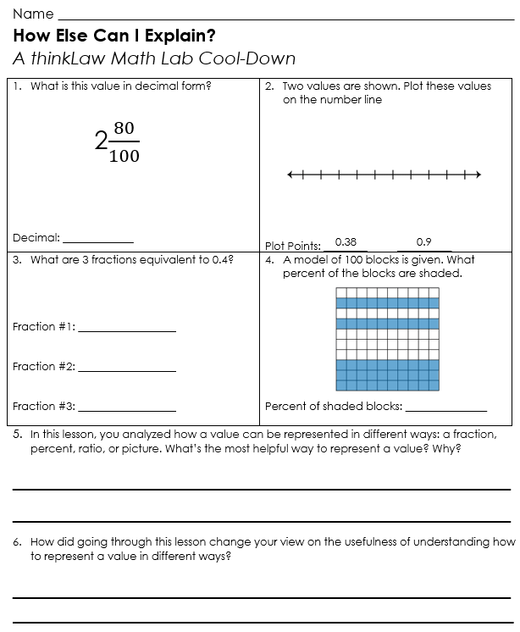
thinkCool-Down
Before we
finish.

