Slide 1
THE COST OF A PERSONAL INJURY
A thinkLaw Math Lab

Slide 2
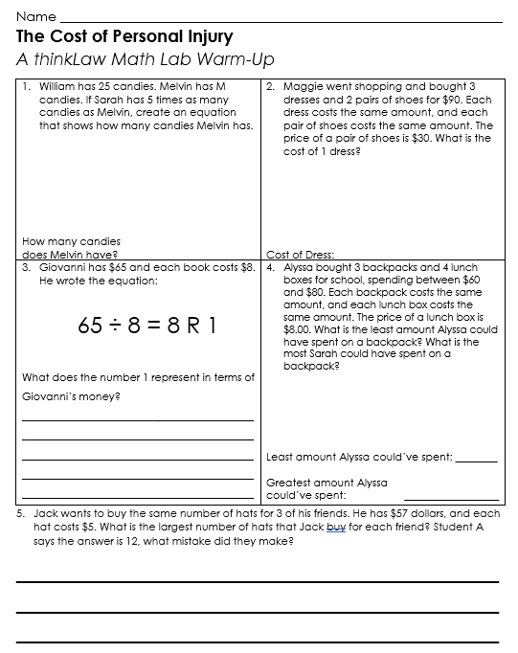
ThinkWarm-Up
Before we begin

Slide 3
thinkStarter
When someone has a headache can you tell how much pain they are feeling? Pain can be tricky because no one can see pain.
Quantify means to explain something in numbers. Quantifying helps us to communicate in a way that other people can understand.

Slide 4
Emergency rooms at the hospital often give people a pain scale.
Why do you think hospitals want patients to quantify their pain?
How does that help doctors?
0
2
4
6
8
10
No Pain
Hurts a
Little Bit
Hurts a
Little More
Hurts
Even More
Hurts a
Whole Lot
Worst Pain Possible

Slide 5
Can you quantify the following?

Slide 6
thinkStarter Summary
Quantifying helps us to make decisions.
In today’s thinkLaw Math Lab, you will look at how quantifying is used to decide how much should be paid in a personal injury case.

Slide 7
The Cost of a Personal Injury
A personal injury is a type of harm that can happen to your body. The injury can be caused by something like a fall, car accident, or dog bite.
Personal injuries can be small, like a bruise or a scrap, or they can be more serious, like a broken bone or head injury.

Slide 8
If you experience a personal injury because of someone else, you can sue.
If you win your case, the defendant, or person being sued, will need to pay you money.
How much money should they pay you? That depends on the seriousness of your injury.

Slide 9
There is a math equation that is commonly used to decide how much a defendant should pay for causing a personal injury.

Slide 10
Blame it on the Rain
(Israel, 1996)
A woman in Israel watched a popular meteorologist named Danny Rup predict the weather. Danny predicted sun for a day that ended up being rainy. The woman claimed that Danny’s forecast caused her to leave her house lightly dressed. As a result, she caught the flu, missed 4 days of work, and suffered from stress.
Assume the woman wins her case. How much should she be paid?

Slide 12
What is the total payout?
Do you believe that amount is fair? Why or why not?

Slide 13
Doorknob Dilemma
(Makara v. Newmark Reality and 40 Worth Associates, New York, 1999)
Cedrick Makara went to use the bathroom in the building where he worked. The bathroom door did not have a doorknob. Cedrick put his hand through the hole where the knob should be. At the same time, someone tried to enter the bathroom. The door smashed into Cedrick’s thumb. Cedrick’s thumb was injured. Cedrick had to miss 6 months of work, have surgery, have physical therapy, and experienced stress.
Assume Cedrick wins his case. How much should he be paid?

Slide 15
What is the total payout?
Do you believe that amount is fair? Why or why not?

Slide 16
Nothin’ But a Bad Time
(Michaels v. CBS, 2009)
In 2009, Rocker Brett Michaels performed his song “Nothin’ But a Good Time” at the CBS Tony Awards. As Brett turned to leave the stage, he hit his face on a set piece that was being lowered to the floor. Brett was knocked to the ground. His accident was shown live on TV.
Brett broke his nose and cut his lip. Ten months later, Brett was rushed to the hospital with a bad headache. Brett had bleeding in his brain that he believes was caused by the accident. He later suffered from a stroke. The rockstar had to cancel several upcoming concerts to complete his treatment.
Assume Brett wins his case. How much should he be paid?

Slide 18
What is the total payout?
Do you believe that amount is fair? Why or why not?

Slide 19
Do you think this formula is the best way to determine the payout in a personal injury case?
Why or why not?

Slide 20
thinkBigger
In our thinkLaw Math lab, we quantified the seriousness of each plaintiff’s, or person bringing the lawsuit, injury.

Slide 21
Who should get to quantify the seriousness of an injury?
What is the best argument for and against each of the following people?

Slide 22
What is your final vote? Who should get to quantify someone’s suffering in a personal injury Why?

Slide 23
What Happened?
Rain
Doorknob
Bad Time
The rain case was thrown out. This means the court never heard the case. Anyone can file a lawsuit, but the court decides if they will hear a case.
Cedrick won his case. He was awarded $3 million.
Brett settled with CBS. They paid him an undisclosed, or secret, amount of money.
.

Slide 24
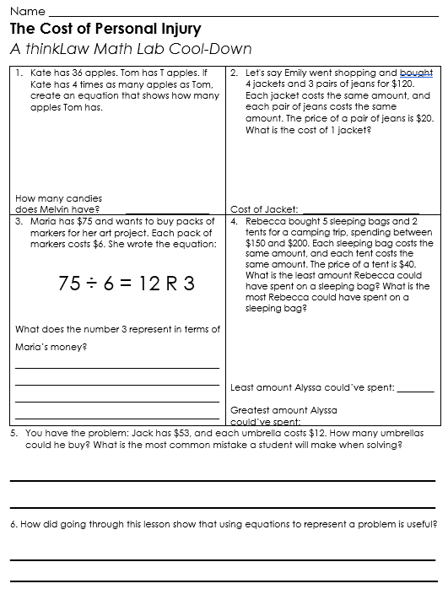
ThinkCool-Down
Before we finish

