Slide 1
Too Much
Junk
A thinkLaw Math Lab

Slide 2
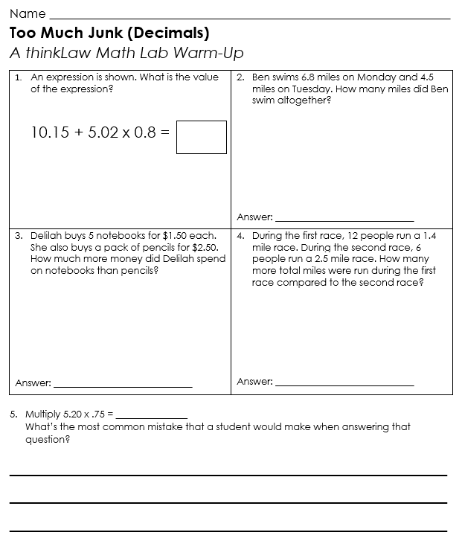
thinkWarm-up
Before we begin…

Slide 3
thinkStarter
Field Trip
Visit a Farm!
$5.00
Imagine that your teacher had a sign in your classroom.

Slide 4
The day of the field trip, the teacher put up a new sign. The field trip has additional fees.
Field Trip
Visit a Farm!
$5.00* Additional Fees
$3.00 Bus Fee
$2.00 Animal Petting Fee
$4.00 Lunch Trash Fee
What is the total cost of the field trip? | What problems would the surprise fees create?

Slide 5
thinkStarter Summary
A fee is a charge. No one likes surprise fees. Surprise fees can create many problems. In our thinkLaw math lab today we will look at surprise fees.

Slide 6
Too Much Junk
Junk fees are “hidden fees” or” surprise fees.” These fees are unexpected or unfair charges that businesses add. The customers see a price for an item, but when they check out the price is much higher because junk fees have been added.

Slide 7
Junk Fee 1: Banking Fees
(U.S. Consumer Financial Protection Bureau v. Bank of America, 2023)
John was at the store, ready to buy his favorite snacks. He reached for his bank card to pay, but the cashier’s machine said the card was declined. John was confused. He tried the card again, but the machine still did not like his card.
It turned out that John did not have enough money in his bank account to pay for the snacks. John did not know this when he tried to make the purchase.
John’s bank has a rule that if you tried to use your card but do not have enough money, they will charge you a $35 fee. This fee is called a non-sufficient funds fee.
How much do you think John should have to pay? Why?
Bank of America charged their customers the non-sufficient every time the card was run. John tried to use the card twice because he did not know why the card was not working. | How much did John have to pay?

Slide 8
Junk Fee 1: Banking Fees
(U.S. Consumer Financial Protection Bureau v. Bank of America, 2023)
Bank of America made a lot of money charging customers the same fee multiple times in one transaction. The U.S. Financial Protection Bureau sued Bank of America over these junk fees.
What is the best argument Bank of America should win? | What is the best argument Bank of America should win?

Slide 9
Bank of America lost this lawsuit. The bank had to pay $100 million in restitution to harmed customers. Restitution means the bank had to make it right. The bank had to pay another $150 million in fines.

Slide 10
Junk Fee 2: Restaurant Fees
(Traveler’s United v. Clyde’s Restaurant Group, Washington D.C., 2023)
Imagine you are at a restaurant called Clyde’s in Washington D.C. You look at the menu and see the prices listed for each dish. But when you get your bill, you are surprised by the total amount. That is because Clyde’s adds a special fee to each item on your bill. This fee is called the “2023 surcharge,” and it is an extra 3.75% that you must pay.
The restaurant does mention the fee at the bottom of the menu, but many people do not read the entire menu carefully. Some people quickly look at the menu online to decide if they can afford to eat at the restaurant, but the price they see is not the actual price they will pay.
A group called Traveler’s United sued Clyde’s. The group says that restaurants should list the full price of each dish, including any fees, so that people know what they are going to pay before they order.

Slide 11
Junk Fee 2: Restaurant Fees
(Traveler’s United v. Clyde’s Restaurant Group, Washington D.C., 2023)
Clam Chowder Menu Price: $8.99 Fee: $0.34 | Cheeseburger Menu Price: $16.99 Fee: $0.64 | Shrimp and Grits Menu Price: $22.99 Fee: $0.86
Jumbo Lump Crab Cakes Menu Price: $25.99 Fee: $0.97 | Braised Short Ribs Menu Price: $36.99 Fee: $1.39 | Fllet Mignon Menu Price: $41.99 Fee: $1.57
How much would you pay in fees if you ordered all these items?
Who should win?
Why?

Slide 12
Junk Fee 3: Traveler’s Fees
(Traveler’s United v Sonesta International Hotels, Washington D.C., 2023)
Sonesta Hotels owns hotels throughout the United States. Customers can go to their website to look for hotel rooms. The listing shows a description of the room and the price to stay in the room for one night. However, when customers reach the final check out page, many fees have been added.
This type of pricing is called drip pricing. Drip pricing means that the company does not show you the full price upfront. Instead, they wait until you have invested time and effort into selecting the room and then add on fees at the end.
Traveler's United, a group that helps people who travel, thinks that drip pricing is unfair. They say that hotels and other companies should always show the full price of a product or service upfront, so that people know exactly how much they are going to pay before they book or buy anything. Traveler’s United sued Sonesta Hotels. They claim the hotel’s drip pricing is unfair to travelers.

Slide 13
Junk Fee 3: Traveler’s Fees
(Traveler’s United v Sonesta International Hotels, Washington D.C., 2023)
The Royal Sonesta Boston lists a hotel room with a king bed and view of the city for $309 a night. Three additional fees are added: Hotel Tax $44.65 Assessment Tax $4.64 Destination Fee $22.03 | How much will you pay for one night?
The Alexis Royal Sonesta Hotel Seattle lists a deluxe room with a king bed for $1,099 a night. Three additional fees are added: Occupancy Tax $29.67 Fee $4.00 Destination Fee $21.98 | How much will you pay for one night?

Slide 14
Junk Fee 3: Traveler’s Fees
(Traveler’s United v Sonesta International Hotels, Washington D.C., 2023)
The Benjamin Royal Sonesta Hotel New York lists a deluxe room with a king bed for $189 a night. Three additional fees are added: State Occupancy Tax $97.54 Development Tax $1.50 NYC Occupancy Tax $64.57 Hotels Facilities Fee $48.20 Room Tax $4.00 | How much will you pay for one night?
Who should win?
Why?

Slide 15
thinkBigger
The Federal Trade Commission, or FTC, is a government agency that works to protect consumers from unfair business practices, like when companies try to hide extra charges until the very end. The FTC wants to make a new rule that says companies must show you the total price of something right from the start, no surprises!
Not everyone agrees with this rule. When a lawyer works to create a solid case, he or she must consider every side of the issue. It is important to be aware of the arguments both sides will present so that the lawyer is prepared. EVEN IF YOU DON’T AGREE with what the other side is arguing, it is important to understand how they view the issue.

Slide 16
Arguments that the FTC should pass the junk fees rule.
Argument | Counterargument
Junk fees are unfair to consumers. They can be hard to understand. Information about junk fees is often hidden in fine print at the bottom of contracts
Junk fees hurt low-income consumers more than any other group. They hurt young people and senior citizens. The White House says Americans pay $65 billion in junk fees each year.

Slide 17
Arguments that the FTC should NOT pass the junk fees rule.
Argument | Counterargument
Businesses must pay more for things they need, like food, cleaning supplies, and other materials. Junk fees can help businesses pay for these higher costs.
Junk fees, like late fees or fees you need to pay when you cancel a hotel room, protect businesses. They help businesses from being taken advantage of by customers who might not pay on time or cancel their plans last minute.

Slide 18
Should the FTC pass the rule? Why or why not?

Slide 19
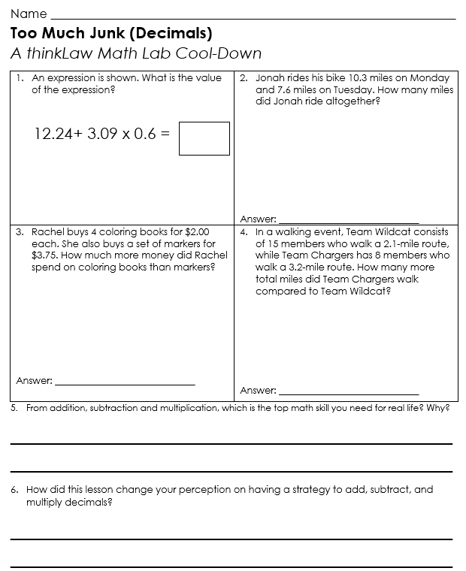
thinkCool-down
Before we finish…

