Slide 1
What is a Math Lab?
(Part 2)

Slide 2
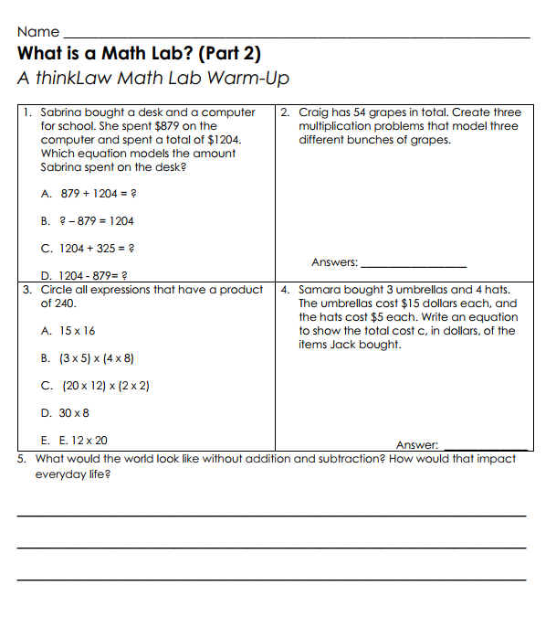
thinkWarm-Up
Before we begin…

Slide 3
A Math Lab is an opportunity for you to try
what you’re learning in math with real-life legal cases and issues!
Math Labs are also an opportunity to listen to the other thinkers in class. They will help you think of more ideas.

Slide 4
Jack bought 2 umbrellas and 3 hats and spent between $30 and $50. Each umbrella costs the same amount. Each hat costs the same amount. The price of a hat is $4.
What is the least amount Jack could have spent for each umbrella?
Solve.

Slide 5
Pretend you are the teacher grading the assignment. Student A and Student B both got the answers wrong.
Jack bought 2 umbrellas and 3 hats and spent between $30 and $50. Each umbrella costs the same amount. Each hat costs the same amount. The price of a hat is $4.00.
What is the least amount Jack could have spent for each umbrella?
Student A
2 x 4 = 8
30 – 8 = 22
Student B
3 x 4 = 12
30 – 12 = 28
What’s your gut reaction, which student deserves to make a better grade? Why?

Slide 6
Look at their work, what mistake did each student make?
Student A
2 x 4 = 8
30 – 8 = 22
Student B
3 x 4 = 12
30 – 12 = 28

Slide 7
Which student deserves to get a better grade?
Student A
2 x 4 = 8
30 – 8 = 22
Student B
3 x 4 = 12
30 – 12 = 28
What’s the best argument for both sides?

Slide 8
As the teacher, what’s your final decision? Which wrong answer is more right?
Student A
2 x 4 = 8
30 – 8 = 22
Student B
3 x 4 = 12
30 – 12 = 28

Slide 9
Now we are going to think about Joe Schmo. Joe always falls for the trick answer. Joe does not read the directions carefully. Joe does not complete all the steps in a problem. We are going to think about the mistakes Joe may make on a math test.

Slide 10
Jack bought 2 umbrellas and 3 hats and spent between $30 and $50. Each umbrella costs the same amount. Each hat costs the same amount. The price of a hat is $4.00.
What is the least amount Jack could have spent for each umbrella?
Let’s go back to the original problem…

Slide 11
Jack bought 2 umbrellas and 3 hats and spent between $30 and $50. Each umbrella costs the same amount. Each hat costs the same amount. The price of a hat is $4.00.
What is the least amount Jack could have spent for each umbrella?

Slide 12
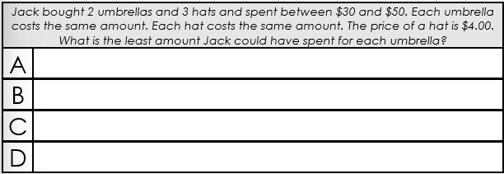
Use these top three mistakes to write 4 multiple-choice answers to the question.
Be sure to also include the correct response.

Slide 13
How is this similar and different to the math we do everyday?
How did it feel to do this type of thinking in math?

Slide 14
In the real world, we must think critically using math.
Why don’t we do that more often in our math classes?
Why is that more fun?

Slide 15
Tips for Math Lab Success

Slide 16
Tip 1
It’s Okay to Not be 100% Sure!
That is the point of the thinkLaw math labs! It’s important for us to tackle big problems together. We learn by trying!

Slide 17
Tip 2
There is Not One “Right” Way
This is an opportunity for you to synthesize or use EVERYTHING you know about math to tackle the problems. Math is flexible. There is more than one way to solve a problem!

Slide 18
Tip 3
Questions, Questions, Questions
Math is supposed to make sense. If something doesn’t make sense, ask! Also, be curious! What do these math labs make you wonder about the world?

Slide 19
Most importantly…
Show Up with Your WHOLE Self and
HAVE FUN!
You can laugh and learn at the same time.

Slide 20
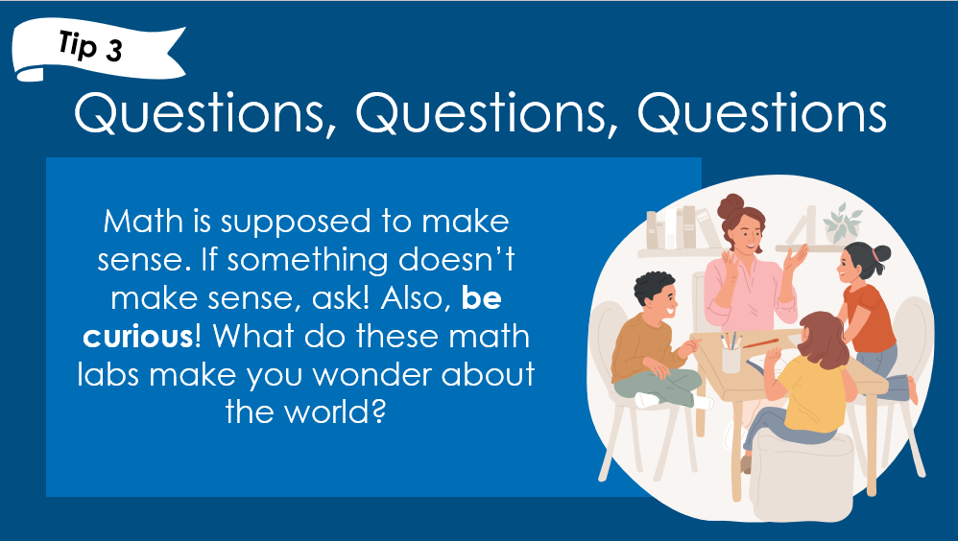
Your neighbor was absent today; how would you summarize this lesson for them?

Slide 21
What would you say to someone who says that we just need to be practicing test prep questions every day?

Slide 22
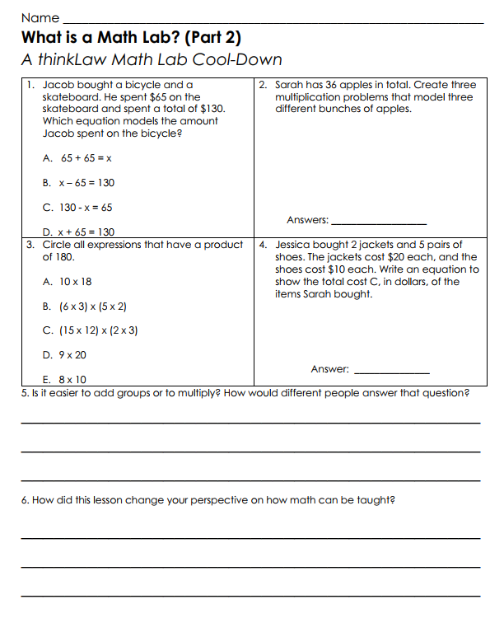
thinkCool-down
Before we finish…

